Slide 1
Past Simple of the verb to be (Was/Were)
Universidad de Cundinamarca
Professor: Nancy ánchez

Slide 2
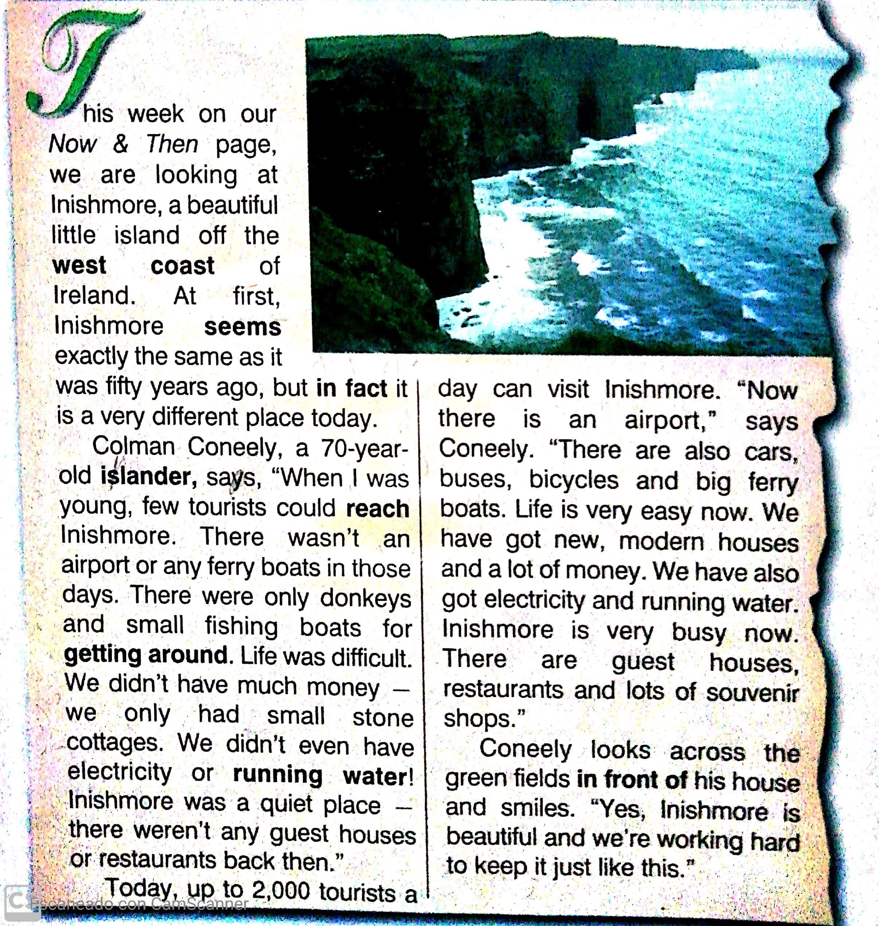

Slide 3
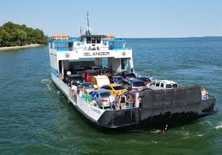
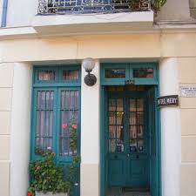

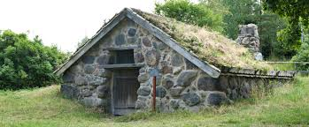
Ferry Boat
Guest house
Stone cotagge
Running water

Slide 4
Compare Inishmore 50 years ago
Then
Now
There were few tourists 50 years ago.
There are many tourists in Inishmore now.

Slide 5
Answer the questions
1. Where is Inishmore?
2. Could many tourists reach the island fifty years ago? Why not?
3. What did the islanders have for getting around?
4. What can you find on Inishmore today that wasn´t there fifty years ago?
5. What does Colman Coneely think of the island?

Slide 6

Tom
is
at school today.
is
was
Tom
was
at home yesterday.
We
are
at school today.
are
were
We
were
at home yesterday.

Slide 7
 | positive | negative | at school yesterday.
I
He
was
wasn’t
She
It
We
were
weren’t
You
They

Slide 8
questions |  | at school yesterday?
I
Was
he
she
it
we
Were
you
they

Slide 9
Short answers
Was
he at home yesterday?
Yes, he
was.
No, he
wasn’t.
Were
you at home yesterday?
Yes, you
were.
No, you
weren’t.

Slide 10

Listening Exercise
Complete the sentences using was-wasn´t-were-weren´t
Where________ you yesterday?
He________at home last night.
_________ the children happy with their gifts?
There_______ any problems.
Do you know where they __________?
You __________ in school last week.
It __________cold this morning.
My students__________ interested in the lesson.
Who _________ at the door?
Those pineapples _______ rotten.

Slide 11














I __________ at home yesterday.
were
wasn’t
weren’t
I __________ at school.
was
wasn’t
were
I __________ happy, because
was
wasn’t
were
my friends __________ at school, too.
was
were
weren’t
They __________ happy, too.
wasn’t
were
weren’t

Slide 12





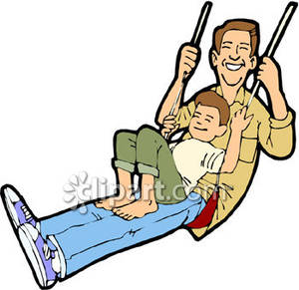



Tom __________ in the playground last week.
was
wasn’t
were
He __________ with his dad.
was
wasn’t
were
Tom’s mum __________ in the playground.
was
wasn’t
were
Tom __________ on the slide.
wasn’t
was
weren’t
He __________ on the swing.
wasn’t
was
weren’t

Slide 13
T HANK YOU

